Slide 1
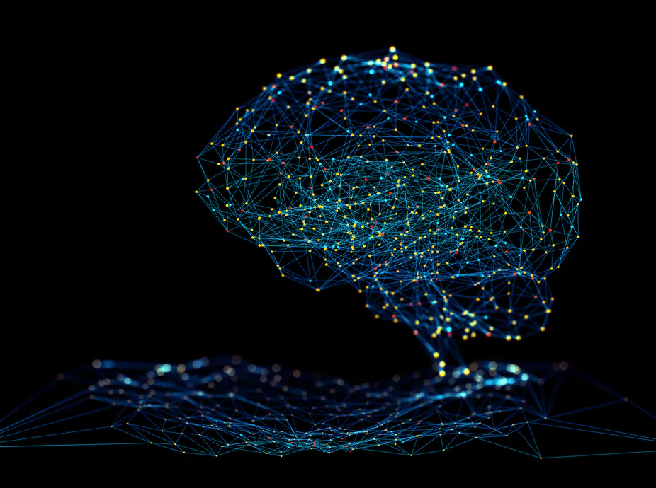
Neural Networks: Unpacking the Black Box
Nathan Lutz
STAT 488
11/17/21

Slide 2
Outline
What is a neural network?
Components of a neural network
Activation Functions
Application
Future Directions

Slide 3
What is a neural network?
Original work came from 1940s
Models developed in the 1980s
The “cornerstone of deep learning”^{[1]}
Takes input vector of p variables (X₁, … X_{p}), builds a nonlinear function, and predicts response Y

Slide 4
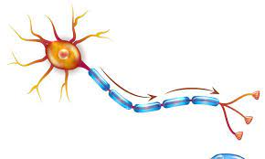
What is a neural network?
Made up of nodes and edges that are named after neurons (brain cells)
Node = “Cell body”
Dendrites receive signal from incoming edge
Outgoing edge = “Axon/Axon terminal”
Neurons only fire if there is a certain ”action potential” reached
Neural networks similarly have activation functions that “fire” under certain conditions

Slide 5
Decisions for Neural Networks
Predictor(s)
Response
Number of hidden layers
Activation Function

Slide 6
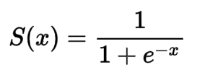
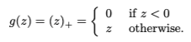
Activation Functions
Not that different from basis functions like regression splines
Sigmoid function
OG activation function
Rectified Linear Unit (ReLU)
More popular in modern neural networks
Others include identity, binary step, hyper tangent, and ramp
Notes:
These functions are important because we can add them together without getting second degree polynomials in the original coordinates of X.
These allow us to model complex nonlinear functions and interactions

Slide 7
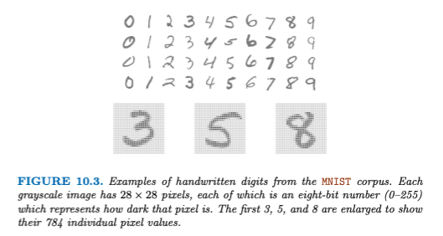
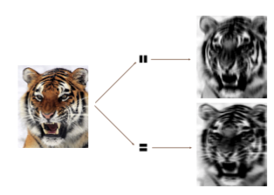
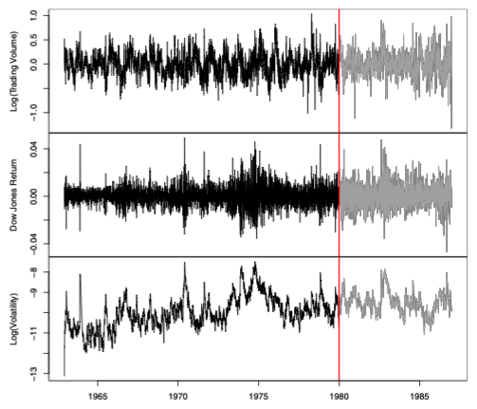
Uses of a Neural Network
Deep learning can solve problems that include:
Identification of handwritten digits or images
Time series forecasting
More simple prediction problems

Slide 8
Returning to the DASS Dataset
Previously used to show how to examine factorial invariance across groups
This dataset also has a question about voting behavior
Using DASS scores and other factors to predict whether someone will vote in an election

Slide 9
To vote or not to vote?
Five predictors
Total DASS Scores
Voters have lower DASS scores (93 vs. 102)
Verbal Scores
Voters have higher Verbal scores (7.1 vs. 6.5)
Critical/Quarrelsome Personality
Voters have slightly lower scores
Sexuality
Larger percentage of voters are heterosexual (67% vs 60%)
Education
Larger percentage of voters are college educated (75% vs. 43%)

Slide 10
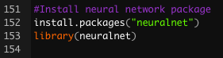
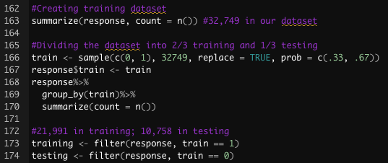
To vote or not to vote?
Three different models
Only difference is number of neurons in the hidden layer
Creating a training dataset and a testing dataset
2:1 training to testing ratio

Slide 11
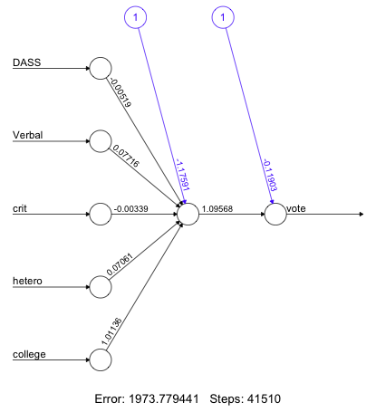
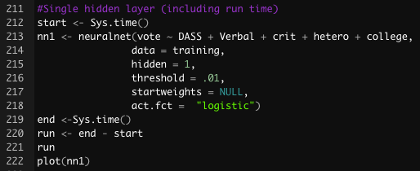
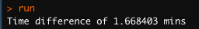
To vote or not to vote?
First model has a single neuron and a single hidden layer
neuralnet() command
Formula/data
# of layers and neurons
Threshold (default = .01)
Startweights
Activation function
Runtime commands
Plot

Slide 12
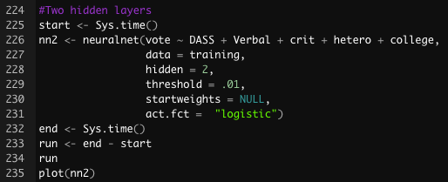
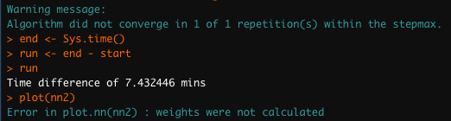
To vote or not to vote?
Second model has two neurons in the hidden layer

Slide 13
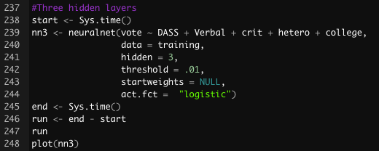
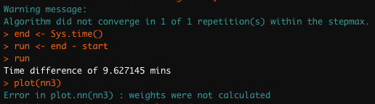
To vote or not to vote?
Third model has three neurons in the hidden layer

Slide 14
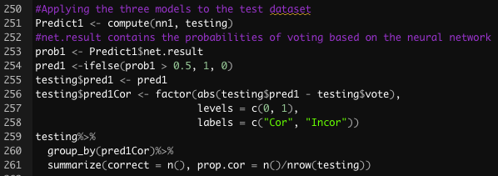
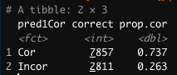
Testing prediction accuracy
Going back to the test dataset with the single neuron model
Note that a model predicting 0% of people as voters is 73.1% accurate
Our model only predicts that 4.9% will vote

Slide 15
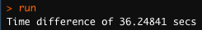
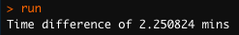
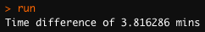
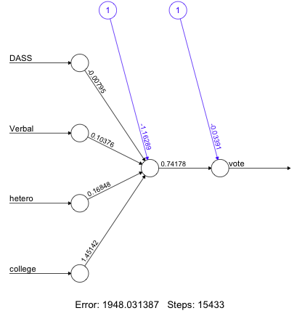
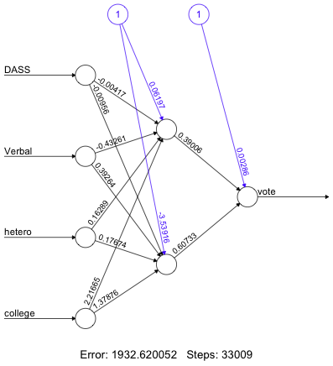
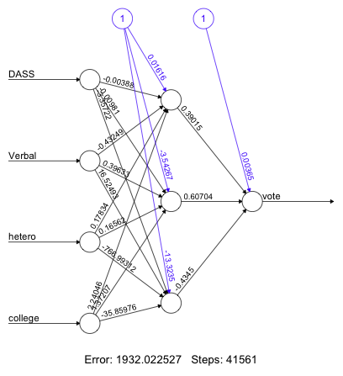
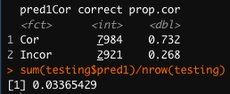
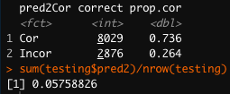
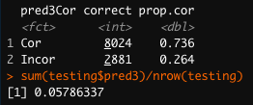
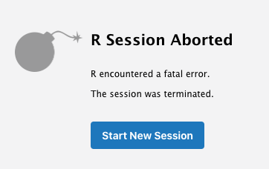
A new model
Removed “crit”
Single neuron
Two neuron
Three neuron
Don’t give up!!

Slide 16
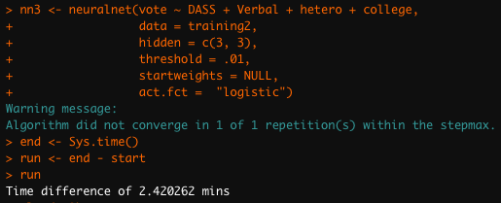
Building out
hidden = c(3, 3) will create a model with 3 neurons and 3 layers
Couldn’t get my model to converge

Slide 17
More Advanced Neural Networks/Future Directions
Feedback/Recurrent Neural Networks
Time series applications
Convolutional Neural Networks
Image recognition applications
Python/Tensorflow
Buying a new computer

Slide 18
References
James, G., Witten, D., Hastie, T., & Tibshirani, R. (2020). An Introduction to Statistical Learning with Applications in R.

